Slide 1
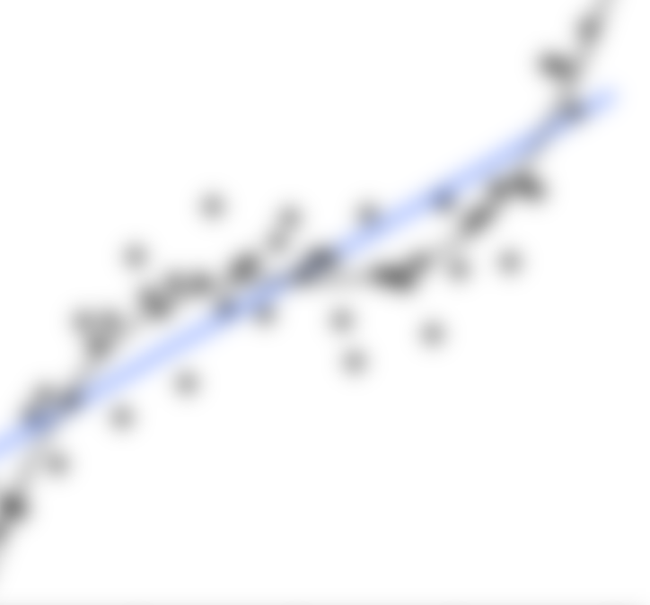
Introduction to dCVnet software for clinical prediction
15/09/2021
Andrew J. Lawrence
github.com/AndrewLawrence/dCVnet
andrew.lawrence@kcl.ac.uk

Slide 2
Outline
Introduction | Background
Examples | Recipe
Discussion Panel
Dr Roland Zahn
Prof Daniel Stahl
Prof Paola Dazzan
github.com/AndrewLawrence/dCVnet
Lawrence et al 2021 BP:CNN 10.1016/j.bpsc.2021.06.010

Slide 3

Preliminaries
Microphones muted
Clarifications/Quick questions during the talk (use Teams “Raise hand”)
Longer questions / discussion for panel at the end

Slide 4
github.com/AndrewLawrence/dCVnet
Lawrence et al 2021 BP:CNN 10.1016/j.bpsc.2021.06.010
dCVnet
double Cross-Validation for the elastic-net
“an easy to use tool for elastic-net regularised logistic regression with double (nested) cross-validation for simultaneous selection of hyperparameters and estimation of generalisation error”
Prediction using binary logistic regression (other families soon)
with Elastic-net regularisation (Ridge, LASSO combination)
and Double cross-validation (a.k.a. nested):
Selection of regularisation hyperparameters
Estimation of generalisation error
an easy to use tool (R wrapper for the glmnet package¹)
¹ Friedman, Hastie & Tibshirani (2010) J. Stat. Soft. 33(1), 1-22

Slide 5
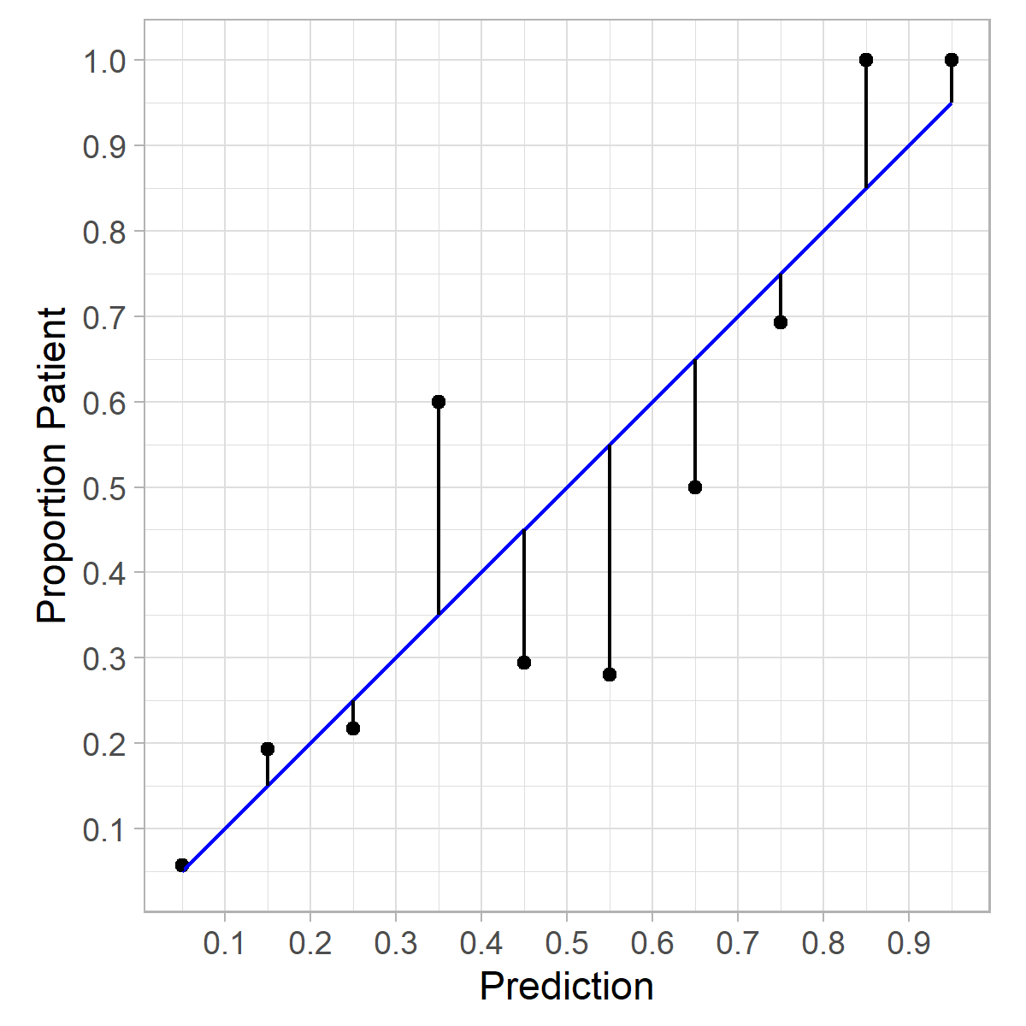
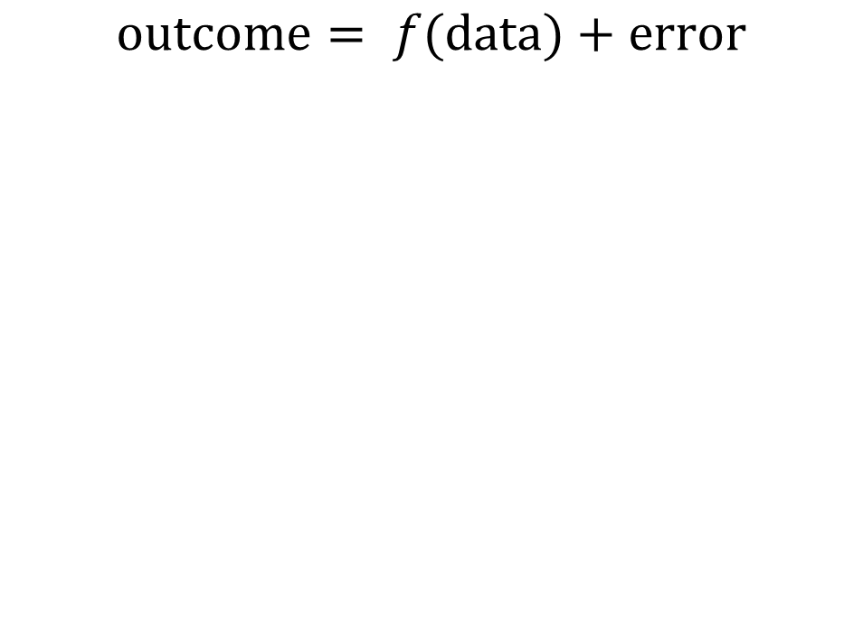
Prediction in a clinical setting
$$\text{o}\text{utcome}= f(\text{data})+\text{error}$$
In general…
Expensive to collect more observations -> small sample sizes
Have good background knowledge about the outcome and predictors from previous research

Slide 6
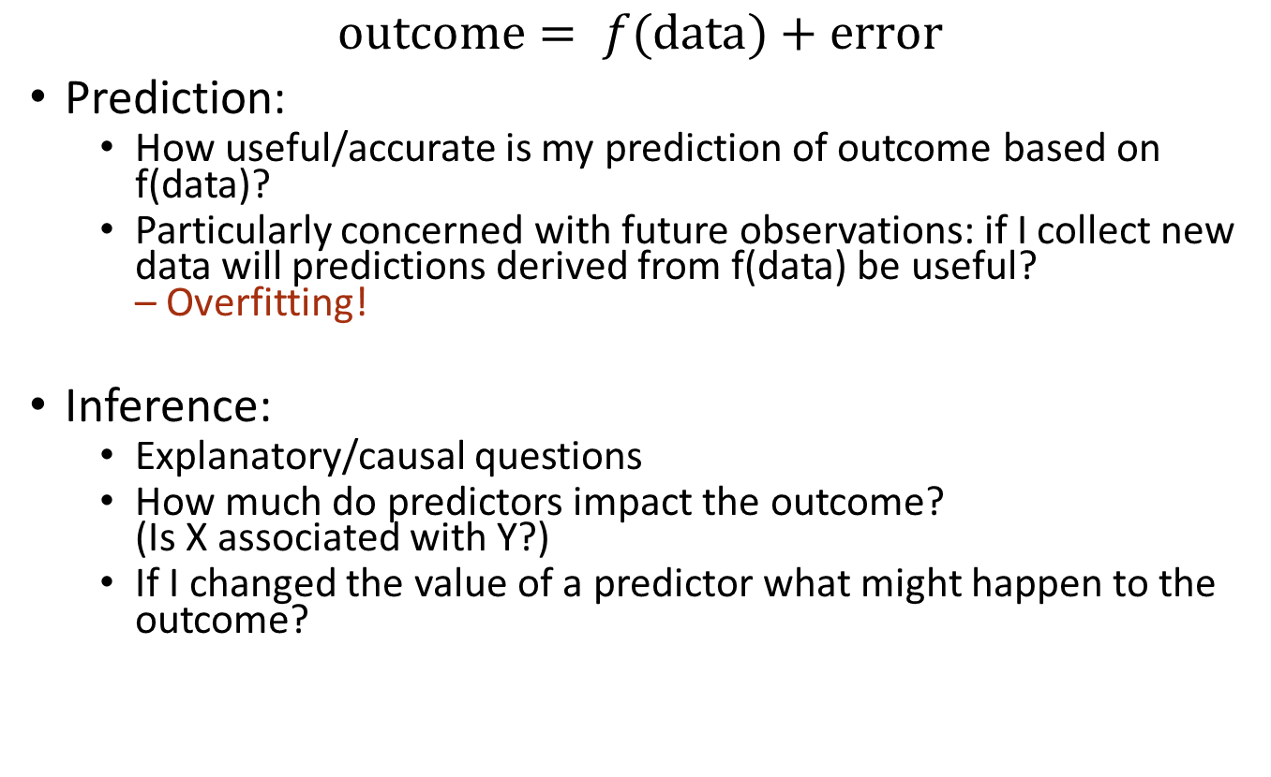
Setting: Prediction (vs. Inference)
$$\text{o}\text{utcome}= f(\text{data})+\text{error}$$
Prediction:
How useful/accurate is my prediction of outcome based on f(data)?
Particularly concerned with future observations: if I collect new data will predictions derived from f(data) be useful? – Overfitting!
Inference:
Explanatory/causal questions
How much do predictors impact the outcome? (Is X associated with Y?)
If I changed the value of a predictor what might happen to the outcome?

Slide 7
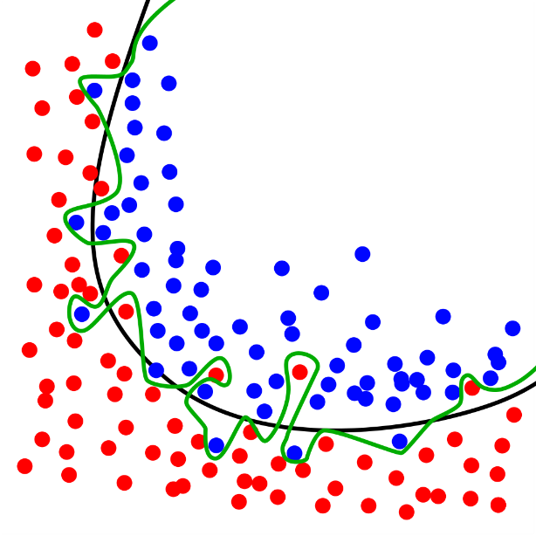
Overfitting
More complicated prediction model -> better prediction when measured in the data used to train the model
Regression: adding any random noise variable will improve performance (when performance is assessed in the data used to train the model)
Neural Networks with enough parameters (and not enough training data) can just encode/memorise input data
Complexity is the number of coefficients or parameters, but depending on the model this can come from:
adding more predictors
modelling non-linear relationships for predictors (quadratic, cubic, splines)
interaction terms between predictors

Slide 8
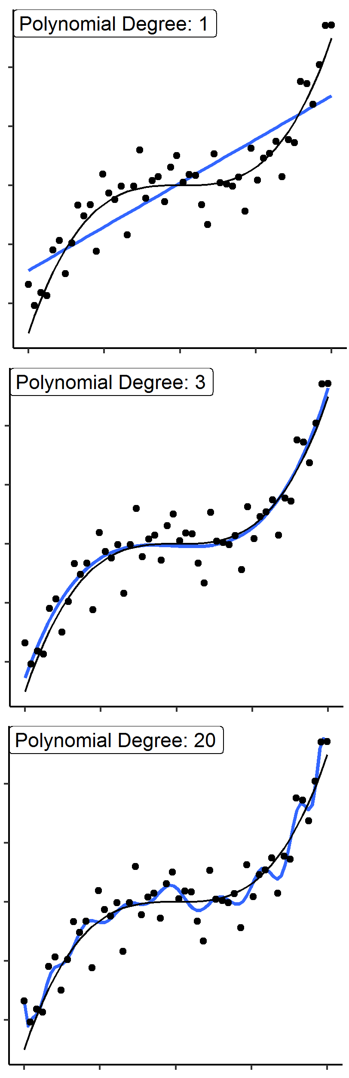
Overfitting
Model
Actual
Where a model too closely reflects the quirks of a particular set of data
The gap between prediction performance on data used to fit the model and performance in new/unseen data: “Generalisation error”
All models will overfit to the data they have seen (they can simultaneously underfit if they lack complexity)
Models with enough training data will not overfit very much.
In inferential statistics overfitting causes high variance regression coefficients which show large and unstable changes when data change, and is one reason for rules of thumb like:
10 cases per predictor (logistic regression)
10-15 samples per predictor (linear regression)
To diagnose overfitting: check performance in unseen data!
Under-fitting
Under-fitting
“Just right”
“Just right”
Over-fitting
Over-fitting

Slide 9
Cross-validation (CV)
# Models
fit
x 1
No Validation
x 1
Hold out (C)V (50%)
x n
Leave One Out CV
+
+
+ … +
Key
x k
k-fold CV (k=5)
Observation
+
+
+ … +
Used to train model
- what type of CV?
Used to test model
Used to both train and test model

Slide 10
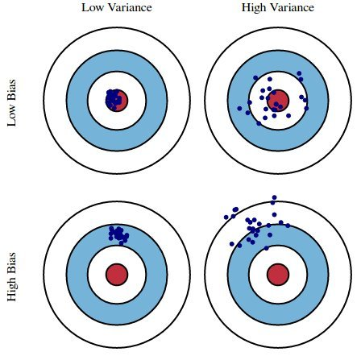
When estimating CV performance, Variance and bias trade-off with k-
Low-k k-fold CV (2-fold) – high bias, low variance
Models fit to less data give less accurate predictions - Pessimistic Bias (LOOCV gives maximum training data of n-1)
High-k k-fold CV (LOOCV) – low bias, high variance
Overlap between training sets (conversely at k=2 there is zero overlap).
Overlap -> correlation -> correlation increases variance.
Impact of noise
Variance can be reduced without affecting bias by picking a new random set of folds and repeating: repeated k-fold CV (but only when k<n as LOOCV is exhaustive).
Variance of an estimator can be more important than bias, particularly for algorithm, hyper-parameter or feature selection.
Widely accepted approach supported by empirical studies¹: a k of 5 or 10 and consider repeated k-fold CV
¹ Hastie, Tibshirani & Friedman - Elements of Statistical Learning

Slide 11
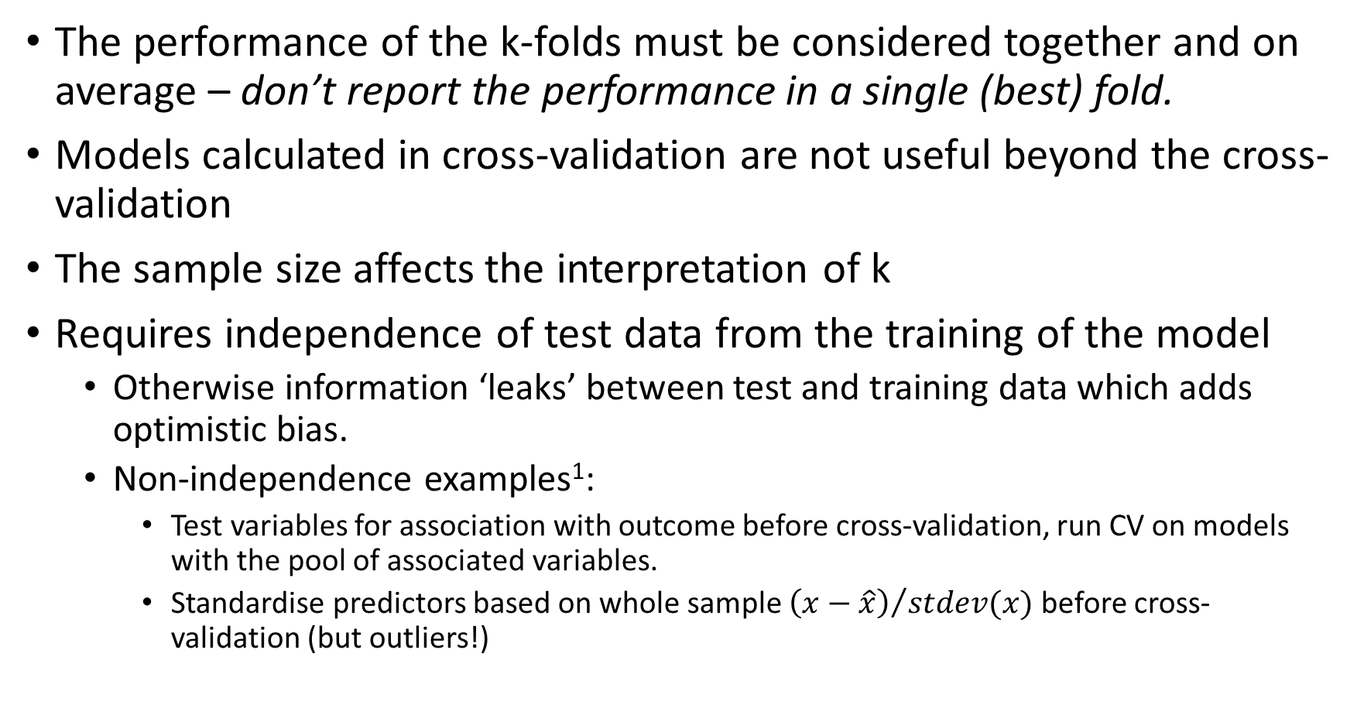
Cross-validation Additional Points & Pitfalls
The performance of the k-folds must be considered together and on average – don’t report the performance in a single (best) fold.
Models calculated in cross-validation are not useful beyond the cross-validation
The sample size affects the interpretation of k
Requires independence of test data from the training of the model
Otherwise information ‘leaks’ between test and training data which adds optimistic bias.
Non-independence examples¹:
Test variables for association with outcome before cross-validation, run CV on models with the pool of associated variables.
Standardise predictors based on whole sample ${\left(x−\hat{x}\right)}/{stdev(x)}$ before cross-validation (but outliers!)
¹ Krstajic et al 2014 J Chemoinformatics. 6(10): 1-15
²Crawley & Talbot 2010 J. Machine Learn. Res. 11: 2079-2107

Slide 12
What to do if there is overfitting?
e.g. you have fit a Logistic Regression to a dataset:
Small sample, lots of predictors
Accuracy in training data: 90%
Cross-validated Accuracy: 60% - the 30% drop suggests overfitting
Common advice:
Collect more data to match the complexity of your model [If you can do this, do it]
Simplify the model by removing predictors (or predictor terms)
Care is required!
to validly reflect generalisation error cross-validation must include the entire model fitting process.
changes are all or nothing (either included or excluded), the actual best solution may be to include a predictor but not as much.
Or: use regularisation (a.k.a. shrinkage) to simplify the model
Regularisation is continuous and the process can easily be data-driven

Slide 13
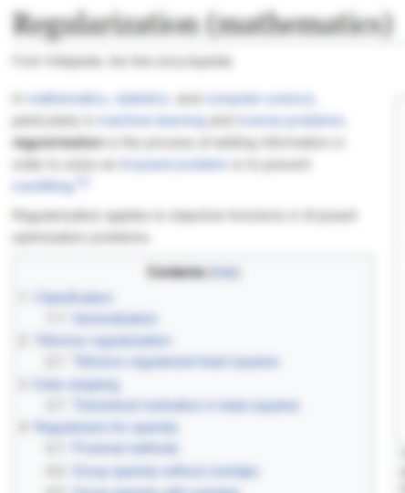
What is Regularisation?
used in the sense of making the solution to the problem more regular - or more smooth.
Smoothness is the opposite of complexity - regularisation attempts to reduce complexity.
Regularisation does this by adding information (information from elsewhere - i.e. not directly from the problem/data).
Comes up multiple terms in different fields / contexts:
Regularisation (of a problem to produce a less complex solution)
Penalisation (of solution complexity)
Shrinkage (towards the added information)
Also… related to priors in Bayesian methods

Slide 14
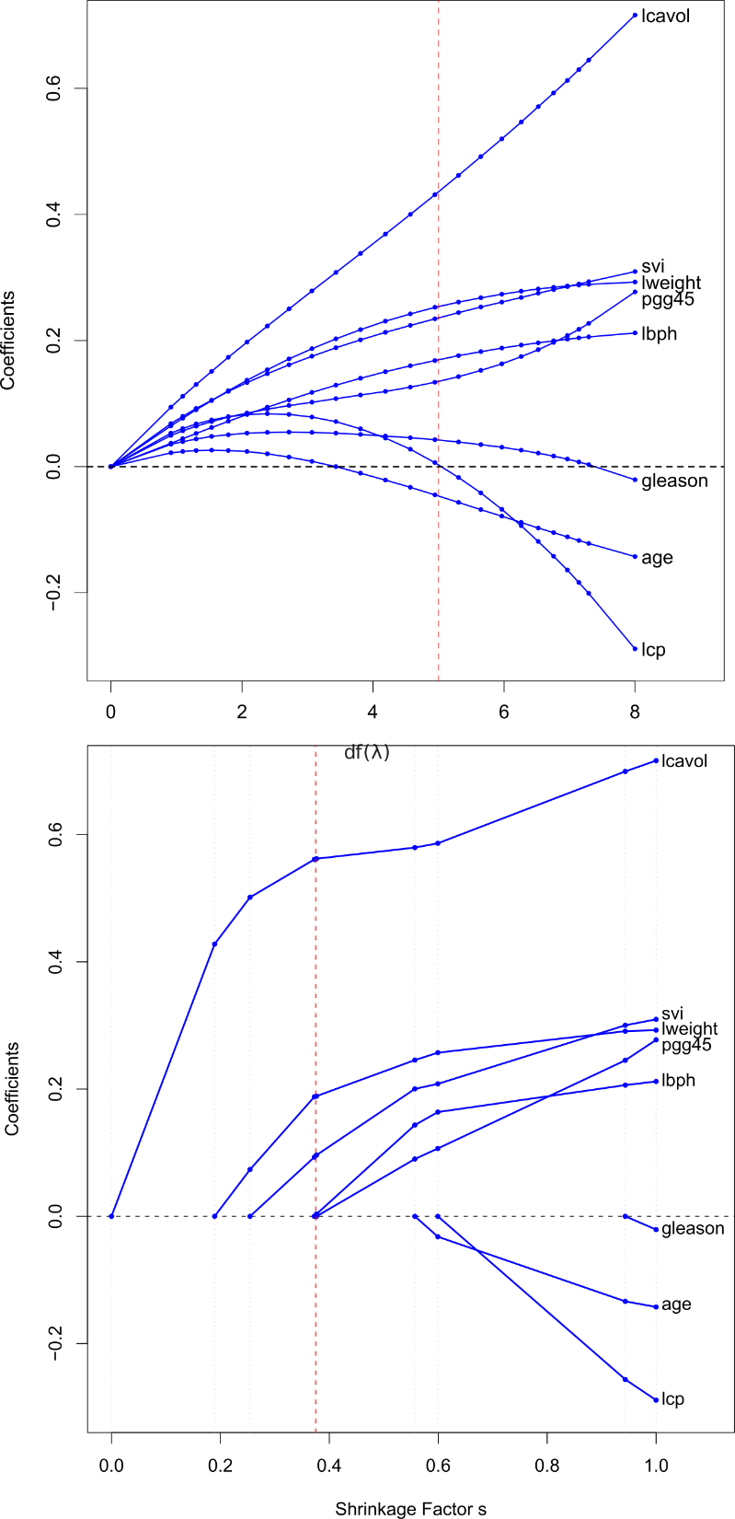
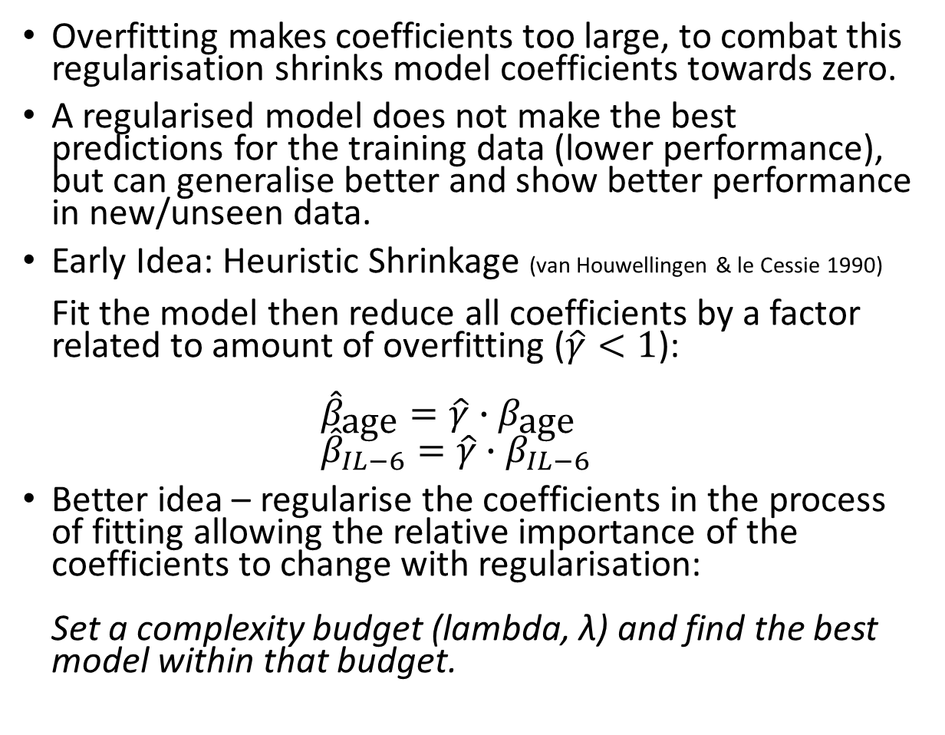
Regularisation
best
Overfitting makes coefficients too large, to combat this regularisation shrinks model coefficients towards zero.
A regularised model does not make the best predictions for the training data (lower performance), but can generalise better and show better performance in new/unseen data.
Early Idea: Heuristic Shrinkage (van Houwellingen & le Cessie 1990) Fit the model then reduce all coefficients by a factor related to amount of overfitting ($\hat{γ}<1$): ${\hat{β}}_{\text{age}}=\hat{γ}∙β_{\text{age}}$ ${\hat{β}}_{IL−6}=\hat{γ}∙β_{IL−6}$
Better idea – regularise the coefficients in the process of fitting allowing the relative importance of the coefficients to change with regularisation: Set a complexity budget (lambda, λ) and find the best model within that budget.
Completely regularised (all coefficients are zero)
Unregularised

Slide 15
Regularisation
Different forms of regularising penalty have different properties:
Ridge Regression
penalise βs based on the L2-norm (sum of squared βs)
good for correlated predictors
Least Absolute Shrinkage & Selection Operator (LASSO)
penalise βs based on the L1-norm (sum of absolute βs)
sets coefficients to zero - variable selection effect
But, unstable with multicollinearity / correlated predictors
Elastic Net
penalise βs based on a combination of Ridge (L2) and LASSO (L1).
A second hyperparameter: alpha determines the balance (alpha = 0 -> Ridge; alpha = 1 -> LASSO)

Slide 16
Regularisation and cross-validation: Hyperparameters
Elastic Net regularisation for the logistic regression should identify sparse/shrunk coefficients to decrease the generalisation error.
But, now need to decide alpha (type of penalty) and lambda (amount of penalty).
Tuning: explore a range of values for λ and α in combination and pick the best performing
The best combination may tune to peculiarities of the sample
Select values for these hyperparameters which produce the lowest generalisation error – by cross-validation.
Observations
1
2
3
4
5
6
7
8
9
10
Split into k-folds
For each fold
Separate the fold as test data
Fit to remaining training data many models exploring different values / combinations of hyperparameters
Evaluate performance in the fold data
Average performance over all folds and pick the combination of hyperparameters with smallest CV-error over all folds
fold1
fold2
fold3
fold4
fold5

Slide 17
Regularisation and cross-validation: Hyperparameters
However: the end goal is still to estimate the generalisation error (out of sample prediction performance).
Any hyperparameter selection (choosing alpha & lambda) becomes part of the model-fitting process and so the selection must be done independently within each fold of the cross-validation to avoid leakage.
The CV estimates we use for tuning are not independent and may be optimistic as a measure of generalisation error.
To estimate generalisation error correctly hyperparameter tuning must be done within the cross-validation loop…
Double (or nested) cross-validation:
An outer loop k-fold CV estimates the cross-validation error
An inner loop k-fold CV estimates the best hyperparameters to choose for each outer loop

Slide 18
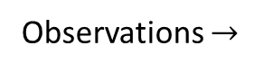
Double (nested) k-fold cross-validation
6
CV-error for model performance calculated using optimised α, λ
Inner Loop evaluates hyperparameters according to CV-performance over held out folds: Models fit to
Outer Loop evaluates CV-performance over held out folds: Models fit to
1
Observations $→$
2
Folds
↓
+
3
Inner Loop evaluates CV-performance for range of hyperparameters in unseen:
5
4
Optimised α, λ
Lawrence et al 2021 BP:CNN 10.1016/j.bpsc.2021.06.010

Slide 19
github.com/AndrewLawrence/dCVnet
Lawrence et al 2021 BP:CNN 10.1016/j.bpsc.2021.06.010
dCVnet
double Cross-Validation for the elastic-net
“an easy to use tool for elastic-net regularised logistic regression with double (nested) cross-validation for simultaneous selection of hyperparameters and estimation of generalisation error”
Prediction using binary logistic regression (other families soon)
with Elastic-net regularisation (Ridge, LASSO combination)
and Double cross-validation (a.k.a. nested):
Selection of regularisation hyperparameters
Estimation of generalisation error
an easy to use tool (R wrapper for the glmnet package¹)
¹ Friedman, Hastie & Tibshirani (2010) J. Stat. Soft. 33(1), 1-22

Slide 20
https://glmnet.stanford.edu/
{glmnet} package for R¹ has an fast algorithm for elastic-net which fits the whole λ-path by cyclical coordinate descent
Lambda hyper-parameter values are computationally inexpensive
glmnet already does k-fold CV to tune lambda
But:
glmnet k-fold CV is singular, no option to do repeated k-fold
No way to tune alpha hyperparameter (the balance of Ridge/LASSO)
No double cross-validation: glmnet estimates of prediction performance are optimistic
Lacks features for exploring results
Few existing software options for conducting appropriate hyperparameter selection and nested cross-validation – all surveyed required substantial programming skills and background knowledge to make appropriate choices.
Honourable mentions: {tidymodels}, {caret}, {mlr3}
¹ Friedman, Hastie & Tibshirani (2010) J. Stat. Soft. 33(1), 1-22

Slide 21
dCVnet details
Wrapper written around fast/efficient glmnet package
Double Cross-validation, with repeated k-fold CV for both outer and inner loops
Inner loop tunes both alpha and lambda hyperparameters (higher resolution lambda with different range for each alpha)
Outer-loop applies the selected hyperparameters and produces detailed prediction performance (calibration, discrimination, classification).
A ‘Production model’ is fit to the complete dataset. Useful for subsequent prediction with new data.
Fully featured prediction measure results, tuning diagnostics, input descriptives - all can be logged to an excel
Convenience:
Stratify cross-validation by outcome
Use R formulas to:
modify variables (~ log(x), ~sqrt(x), ~ poly(x,3))
include interaction terms (e.g. ~ x * y, ~ (x + y + z)^2))
ROC plots

Slide 22
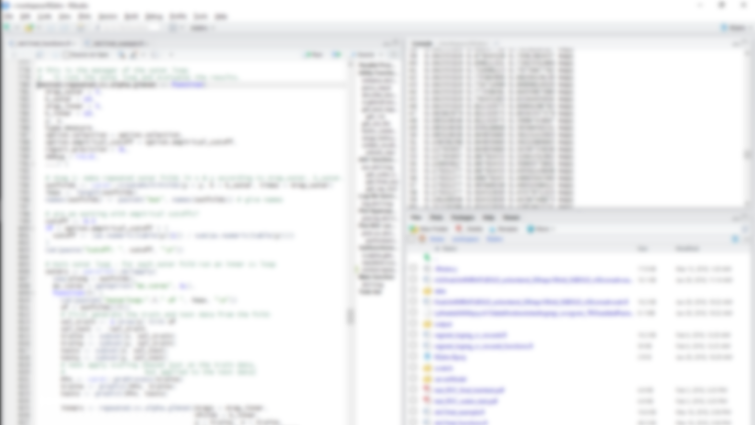
Getting Started
1. Download and install R and RStudio
2. > remotes::install_github("AndrewLawrence/dCVnet")
3. > library(dCVnet) > example(dCVnet, run.dontrun = TRUE)
Full instructions: https://github.com/AndrewLawrence/dCVnet
New to R for science?: https://software-carpentry.org/

Slide 23
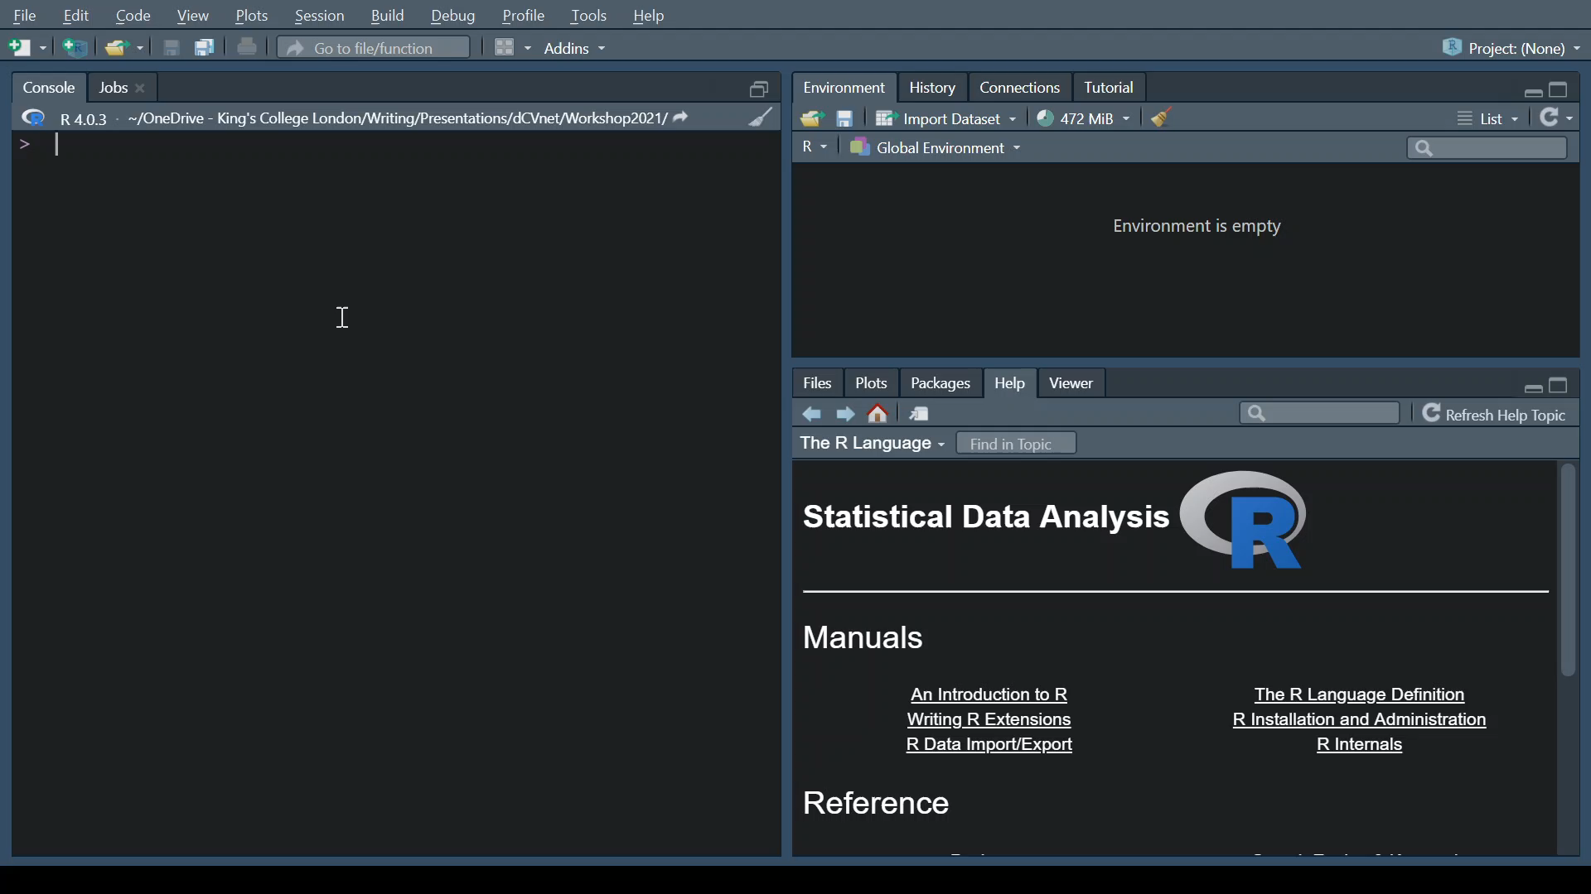

Slide 24
Running dCVnet
R package
Input: data.frame or matrix (import from spss, stata, csv) outcome vector model formula (e.g. "~ ." gives all predictors in data)
Options:
Crossvalidation:
Folds stratified by outcome?
Inner: #folds, #reps
Outer: #folds, #reps
Hyperparameter search:
# lambdas
alpha values
Hyperparameter selection:
model metric {deviance, AUC, class error}
parsimony in lambda {none, +1S.E.}

Slide 25
Running dCVnet
my_model <- dCVnet(
y = my_outcome,
data = my_dataframe,
f = "~ ."
)
save(my_model, "my_model_backup.RData")
log_results_to_excel(my_model, "my_model_output.xlsx")
summary(my_model)
plot(my_model, type = "roc")
Note: ?dCVnet to see help documentation with defaults for options
By default will run 2x10-fold outer-CV and 5x10-fold inner-CV

Slide 26
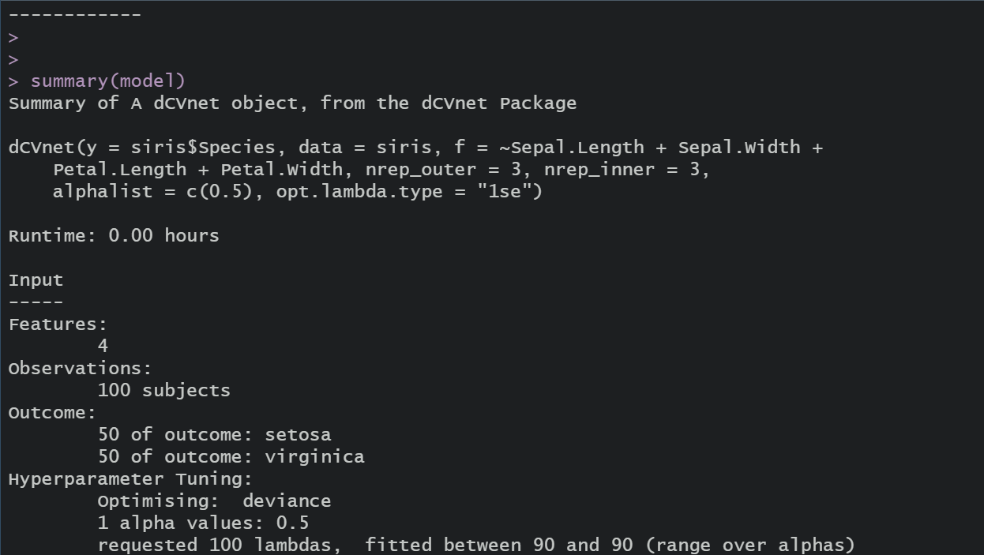

Slide 27
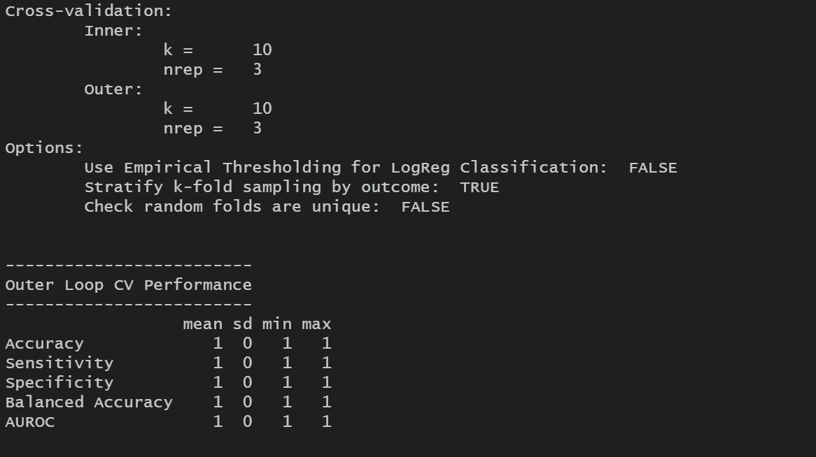

Slide 28
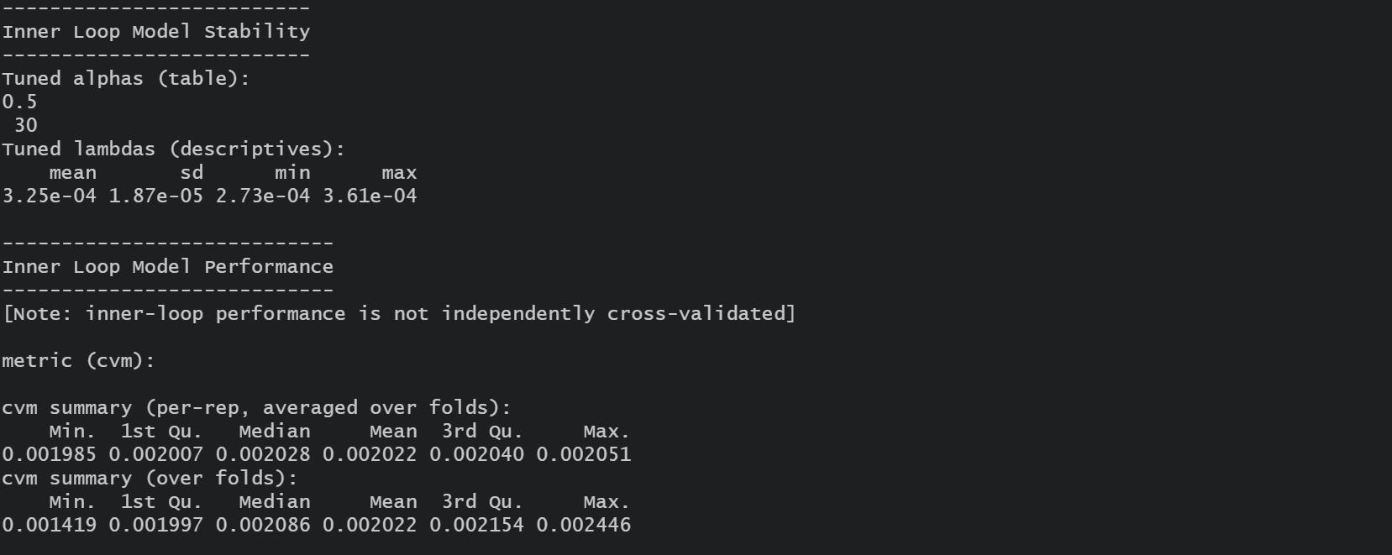

Slide 29
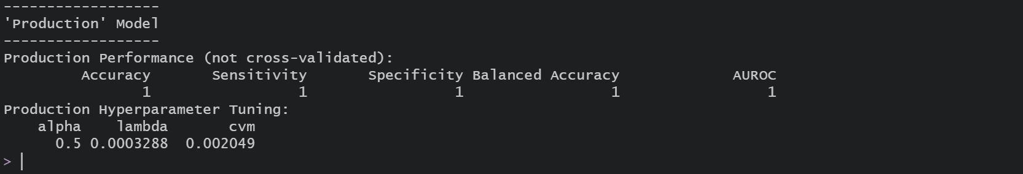

Slide 30
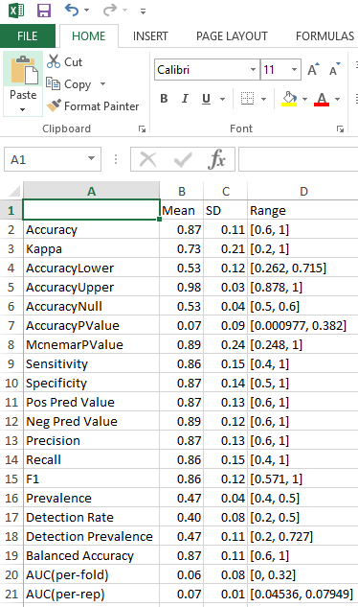
Output
Excel format logfile
Function call, options, timing data, descriptive statistics for the input data.
CV Classification statistics (Accuracy, Sensitivity, Specificity, PPV, NPV, AUC, Brier Score, Calibration Intercept and slope)
CV Average Classification tables
Inner loop selected hyperparameters
Outer loop classification performances
Descriptives for the ‘Production Model’
ROC plots (outer loops & production model)
Hyperparameter Tuning plots (pdf)
Backup model (compressed R object)

Slide 31
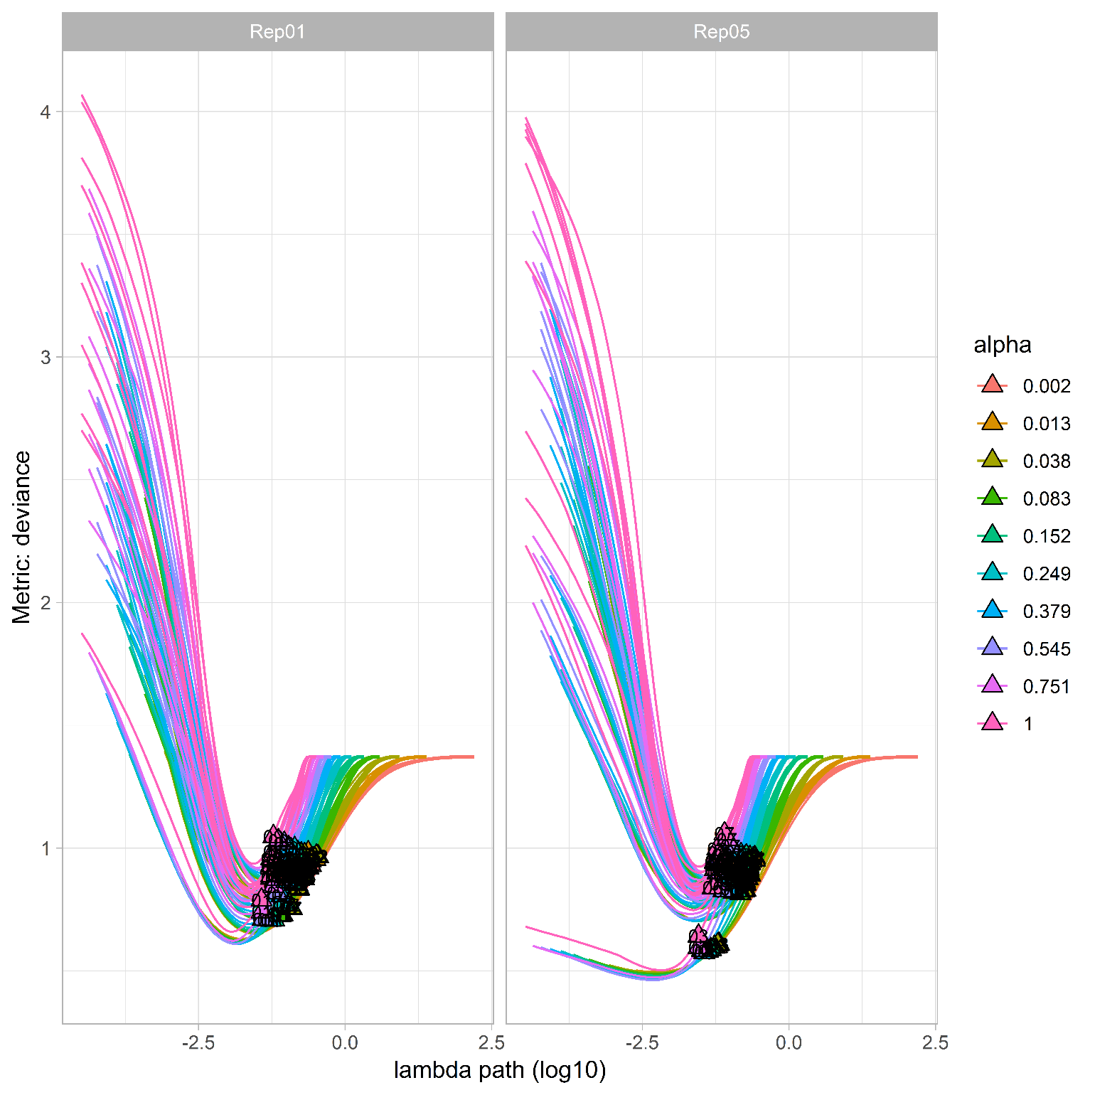
Example Tuning Plot
plot(my_model, type = "tuning")

Slide 32
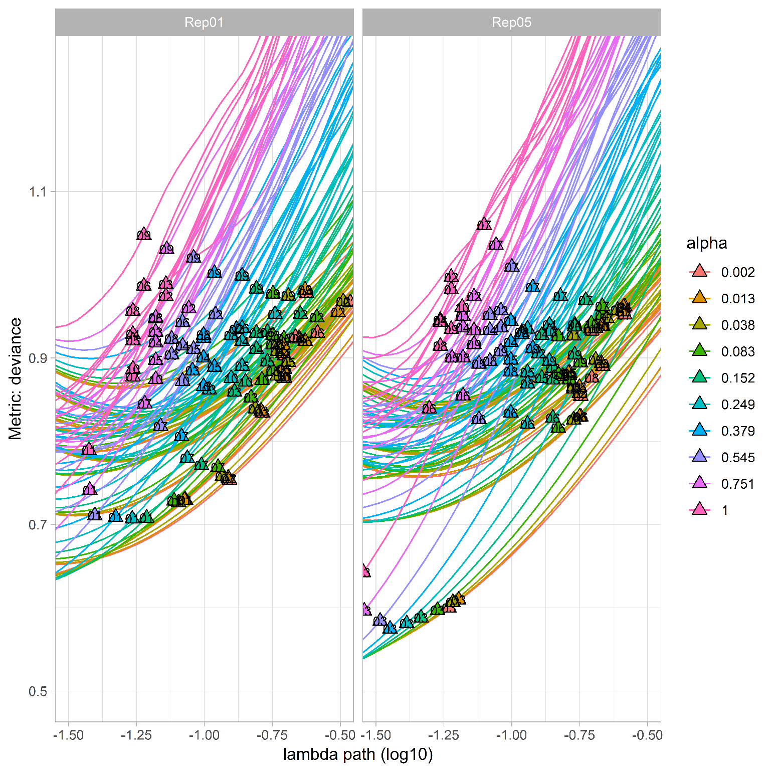
Example Tuning Plot (detail)

Slide 33
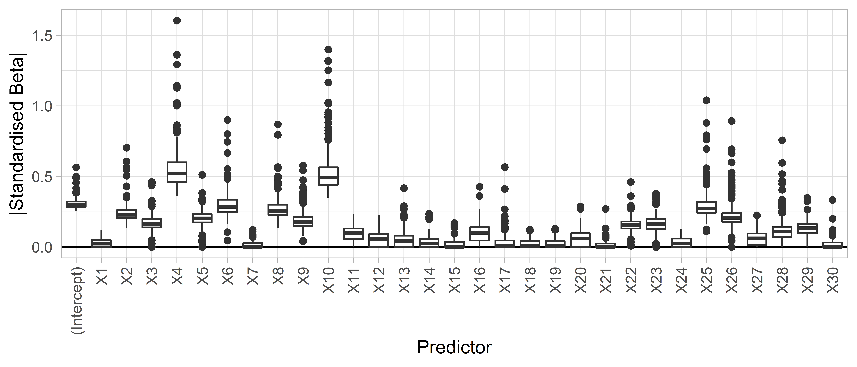
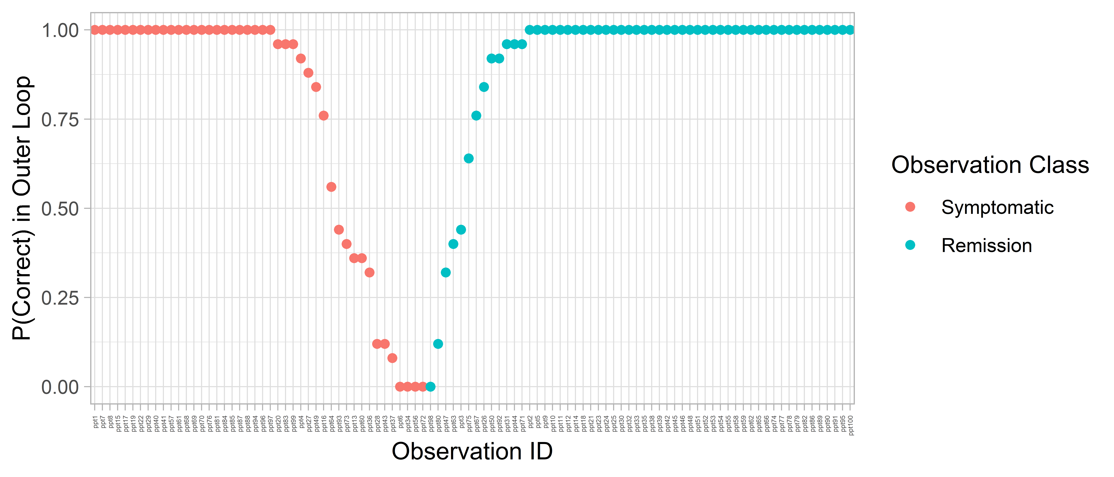
plot_outerloop_coefs(my_model)
Explore Predictors:
casesummary.performance(performance(my_model))
Explore Observations:

Slide 34
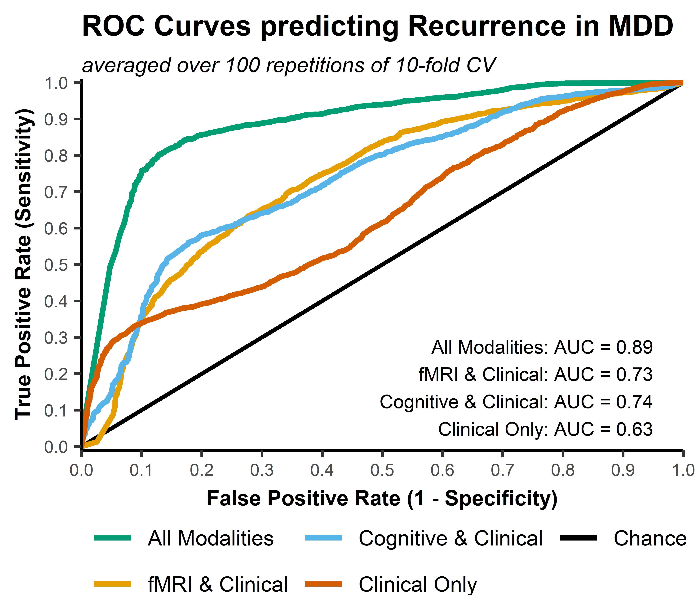
50 subjects (32% recurrence)
25 predictors
Outer: 100 reps 10-fold
Inner: 30 reps 10-fold
Metric: Classification accuracy
100 lambda values, 4 alpha values
Lambda ≈ 0.0036; alpha ≈ 0.4
CV Accuracy 83%
CV Sensitivity 67%
CV Specificity 90%
Lawrence et al 2021 BP:CNN 10.1016/j.bpsc.2021.06.010

Slide 35
dCVnet Recipe
Prepare data (outcome and predictors)
Does R "understand" my data right? `str(my_data)`: are unordered / ordered factors and continuous variables coded correctly?
What formula will I use? (which predictors to include?, do any predictors need to be transformed?, are there any non-linear relationships or interaction effects?)
Set reference level of the outcome (particularly important for classification metrics like sensitivity/specificity)
Note: missing data is not supported and dCVnet enforces complete cases on its input.
https://software-carpentry.org/ for R tutorials on the above
Run dCVnet with default settings
Save model & inspect results
Done [usually]
Check the excel log, was the command as expected? Check descriptives for the outcome and predictors.
Inspect tuning plots, performance within inner loop, variability over cross-validation folds. Does a second dCVnet differ much? Do I need to improve tuning or smooth the cross-validation?
Consider running dCVnet with bigger range of hyperparameter tuning settings, more CV repetitions, smaller folds (increase k).

Slide 36
Running dCVnet: CV options
my_model <- dCVnet(
y = my_outcome,
data = my_dataframe,
f = "~ .",
k_outer = 15,
k_inner = 15,
nrep_outer = 250,
nrep_inner = 30
)
250x5-fold outer and 30x5-fold inner

Slide 37
Running dCVnet: LASSO with many predictors
my_model <- dCVnet(
y = my_outcome,
data = my_dataframe,
f = "~ .",
nlambda = 1000,
alphalist = 1.0
)
By default dCVnet runs 100 lambda values, but more resolution can be useful if there are a large number of predictors (or if the tuning curves look rough).
Setting alphalist to a single value means alpha will not be tuned for this model

Slide 38
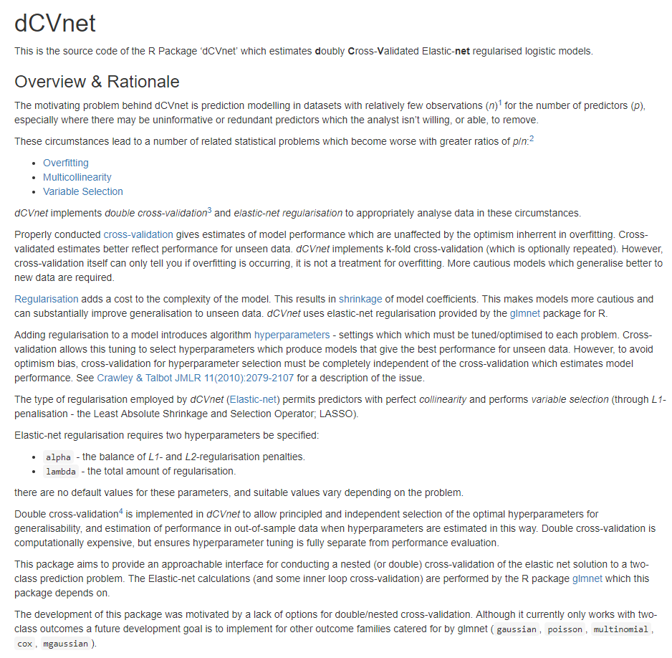
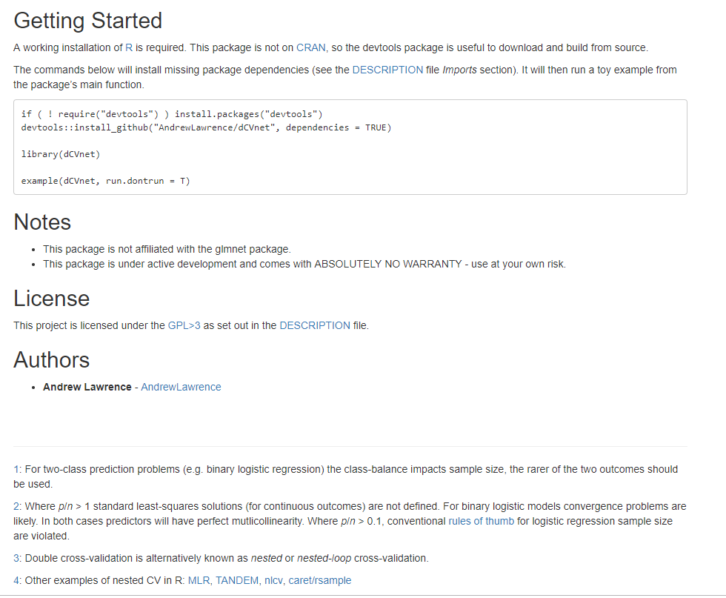
dCVnet is… documented

Slide 39
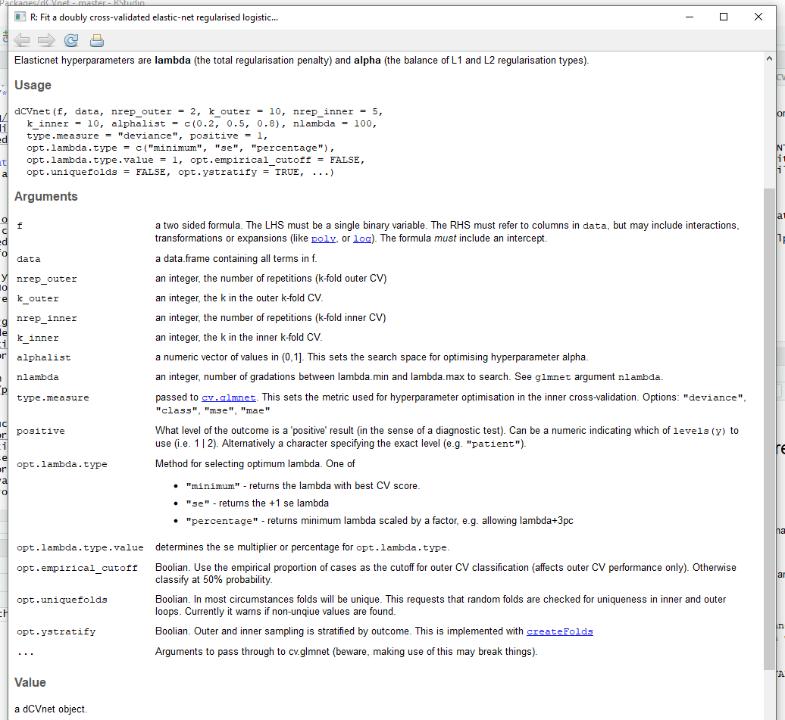
dCVnet has… help and examples
> ?dCVnet
> help('dCVnet')
> example(dCVnet)
> vignette(package = "dCVnet")
> ?dCVnet-package

Slide 40
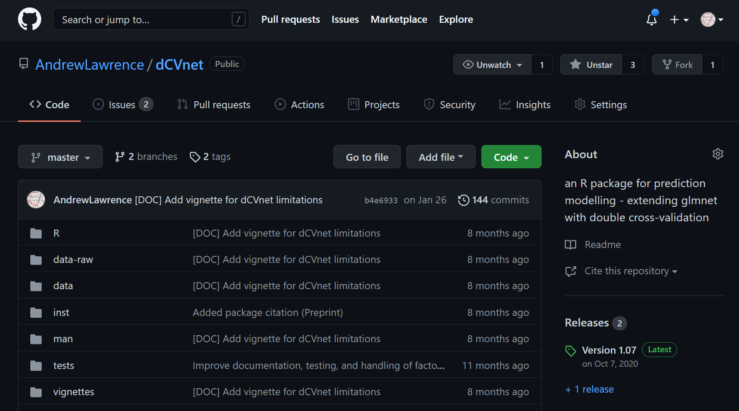
github.com/AndrewLawrence/dCVnet

Slide 41
Performance
Run time depends on:
Number of observations
Number of predictors
Number of lambdas for tuning
Number of alpha values for tuning
Inner and outer k-fold k
Inner and outer nreps
Computation time scales poorly (inner reps * outer reps * outer k)
How many reps:
more is better
evaluate fold/rep-variability
evaluate run-to-run variability
Parallelisation of the outer loop (currently linux only)
But… early testing suggests it's faster than equivalent double cross-validation in a general ML toolkit
The basic prediction problem
Cross-validation

Slide 42
Wrapping up…
What circumstances might dCVnet be useful?
Goal is prediction
Want an explainable ‘non-glass box model’
Unregularised model is overfitting
Multi-collinearity / correlated predictors
Some variables may be unrelated to the outcome
Mixture of continuous and categorical predictors
What is dCVnet unlikely to be useful for?
Inference about model parameters
Many more observations than predictors (big data, no overfitting)
Form of predictor-outcome relationships probably substantially non-linear
Dependencies between observations (hierarchical models, time-series)
Missing data: must be omitted or imputed – imputed within CV folds?

Slide 43




Acknowledgements
Prof. Daniel Stahl (Biostatistics & Health Informatics, NIHR-BRC)
Dr Deborah Agbedjro (Department of Biostatistics, IoPPN)
Dr Roland Zahn (Centre for Affective Disorders, IoPPN)
Prof. Paola Dazzan (Psychological Medicine, IoPPN)
Maudsley NIHR Biomedical Research Centre (https://www.maudsleybrc.nihr.ac.uk/)
R: A Language and Environment for Statistical Computing (www.R-project.org)
glmnet package authors (https://cran.r-project.org/web/packages/glmnet/)
github.com/AndrewLawrence/dCVnet
Lawrence et al 2021 BP:CNN 10.1016/j.bpsc.2021.06.010
andrew.lawrence@kcl.ac.uk

